Slide 1
GIT
BHAVANA
DAY 6
08/04/2024

Slide 2
PUSHING FILES TO THE REPOSITORY USING GIT:
git clone git@<url of git repository>
Git status
Git add .
Git commit –m “hi”
Git status
Push origin main

Slide 3
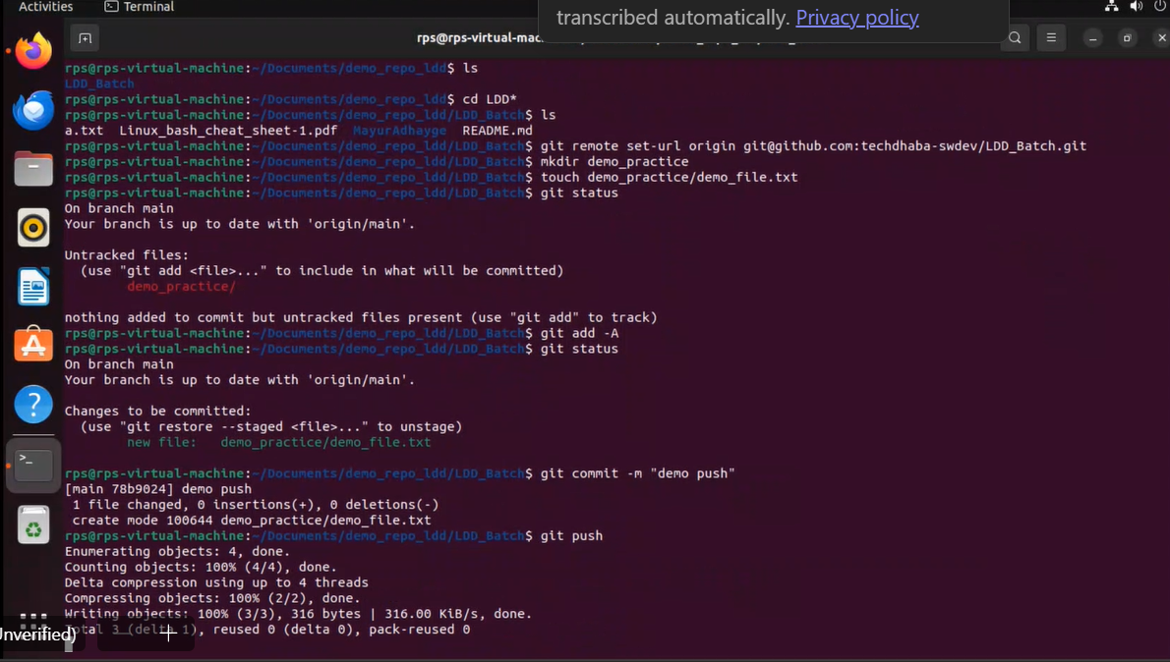

Slide 4
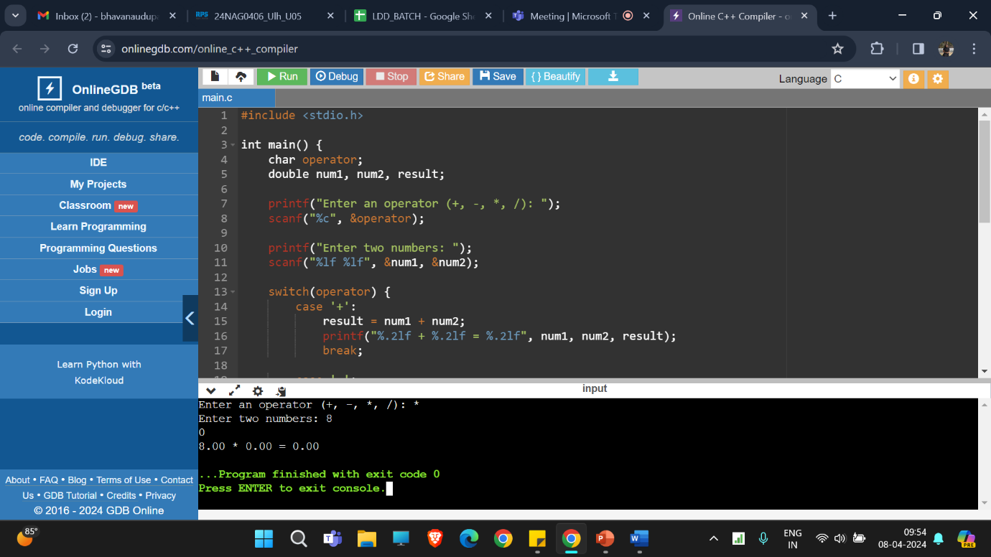
C program for simple calculator:

Slide 5
Git log: gives information about edits.
Git branch: gives which branch we are at
git init: This command creates a new Git repository in your current directory. This is the first step to start tracking changes in your project.
git add: This tells Git which files you want to include in your next commit. You can add individual files or use git add -A to add all modified files.
git commit: This captures a snapshot of your project at a specific point in time. You'll usually provide a message describing the changes you made.
git status: This shows you the current state of your project. It tells you which files are modified, staged (added for the next commit), or untracked (not yet added to Git).
git log: This displays a history of all the commits made in your project. You can see who made the commit, the message they provided, and the date.
git clone: This is how you copy an existing Git repository from a remote location (like GitHub) to your local machine.
git checkout: This is how you switch between different branches in your project. Branches are essentially copies of your project that allow you to work on new features or bug fixes without affecting the main codebase

Slide 6
Discarding Changes:
git clean: This removes untracked files (files not added to Git) from your working directory. Use with caution!Branching and Merging:
git branch: Lists existing branches or creates a new branch.
git checkout -b <branch_name>: Creates a new branch and switches to it in one step.
git merge <branch_name>: Combines changes from another branch into your current branch. This can involve resolving conflicts if the same files were modified in both branches.Remote Repositories:
git remote add <name> <url>: Adds a remote repository (like GitHub) to your local project.git fetch: Downloads the latest changes from the remote repository without merging them into your local branch.
git pull: Fetches changes from the remote repository and merges them into your current branch (similar to git fetch followed by git merge).
git push: Uploads your local commits to the remote repository.
Additional Tips:Use git log --graph to see a visual history of your commits and branches.Practice on a small project to get comfortable with the commands before using Git for important work.There are many helpful Git GUIs (graphical user interfaces) available if you prefer a visual approach

Slide 7


